Slide 1
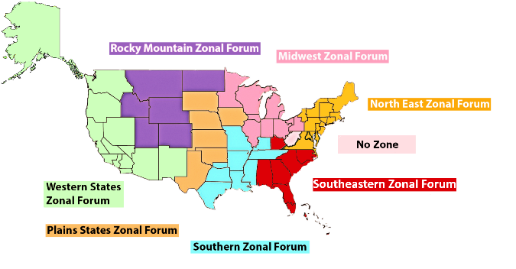
US Collaboration of Zones:
What, When, Why, How
October 2025

Slide 2

What is a Zone
Zonal Forums are service-oriented sharing and/or business sessions that provide the means by which NA communities can communicate, cooperate, and grow with one another. Although not a part of NA’s formal decision-making system, world services and zonal forums interact in many ways. Their role is to complement the regions in their service to the groups and areas. Zonal forums with two or more zonally seated regions or communities that are not seated at the World Service Conference may choose to send a zonal delegate to the WSC

Slide 3
NA Zones in the United States

Slide 4
The Background Story
World Service Conference of The Future project 2018 had a goal to strengthen collaboration between zonal forums and between NAWS/zonal forums
Virtual Meeting of Zones was created in 2019 as a result to share best practices; 15 zones from around the world meeting together
Representatives of the *eight Zonal Forums serving NA Regions in the United States expressed interest in meeting for the purpose of coordinating efforts.
The first meeting in December of 2019 identified many opportunities for US zones to collaborate.
*Eight at that time. The Autonomy Zonal Forum joined the Northeast Zonal Forum in 2024
Notes:
This effort emerged from the virtual meetings of the 15 Narcotics Anonymous Zonal Forums from around the world that began in early 2019.
As a result of those meetings, representatives of the eight Zonal Forums serving NA Regions in the United States expressed interest in meeting for the purpose of coordinating efforts.
The first meeting in December of 2019 identified many opportunities for Zonal Forums within the US to collaborate.

Slide 5
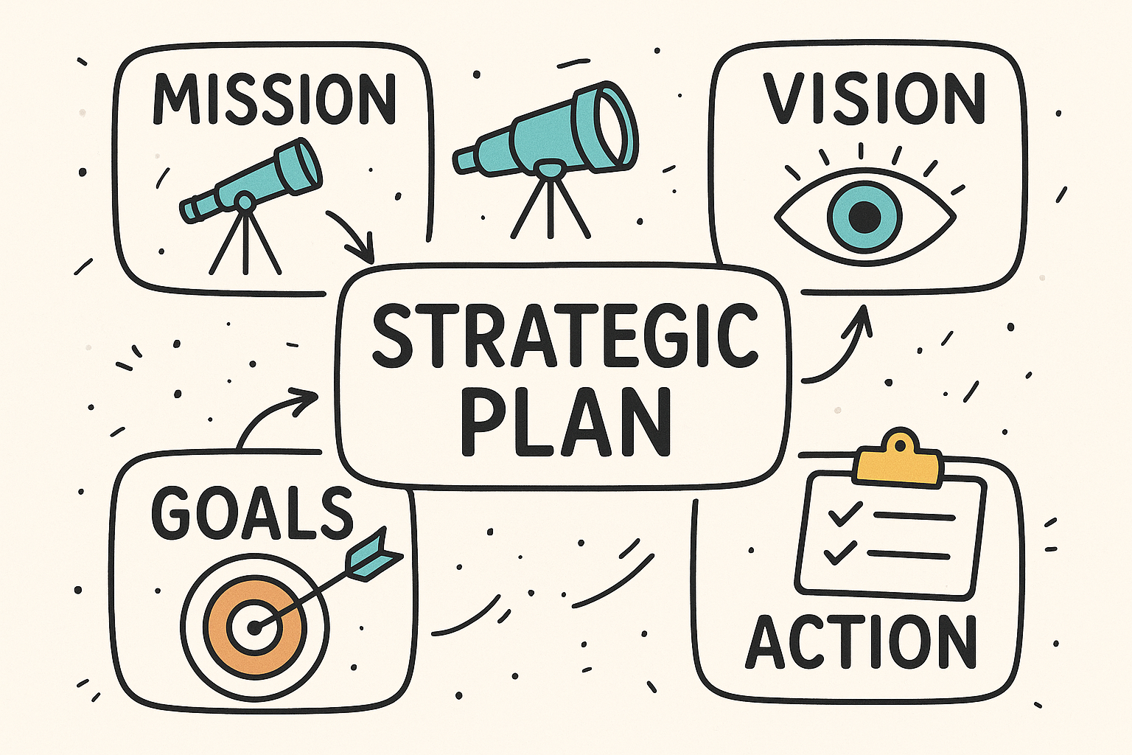
Who We Are!!
Our Guiding Principles, Practices and Services for You

Slide 6
🌟 Vision & Mission
  To provide a single point of contact for Narcotics Anonymous in the United States, creating a national
  presence that enables broad Public Relations opportunities.
  Work with national and federal agencies currently closed to NA
  Offer a national website linking to local meetings, phonelines, and websites
  Distribute national PSA campaigns to increase awareness
  Help improve the quality and accuracy of meeting info locally & on na.org
📌 Organizational Structure
  🏛️ Recognized and approved as a service body – January 2024
  🙋 Elected leadership roles established:
    Facilitator
    Secretary
    Workgroup Leaders for:
      Information Technology
      Communications
      Public Relations

Slide 7
How We Serve NA Communities: Communication, Collaboration, Cooperation, Strategic Planning
  📢 Public Relations
  🌱 Fellowship Development
  🎓 Training & Mentorship
  💻 Technology
  📈 Planning & Reporting
Our Role in the Service Structure
  ✅ Complement, Not Replace; We work alongside existing NA service structure—not in place of it.
  🧠 Coordinate Knowledge & Resources; bring together experience, tools, and information from across
  zones to support local efforts.
  🔄 Funnel Requests for Service; when inquiries come in, we connect them with the appropriate local
  service body to offer support as needed.

Slide 8
Workgroups
🗣 Communications
💻 Information Technology (IT)
📣 Public Relations

Slide 9

Communication
📥 Monitors Incoming Requests
  Tracks service requests & inquiries
  Updates monthly communication log
🔗 Connects Requests with Resources
  Local Requests
    Contacts zonal reps first
    Supports outreach to regions/areas as needed
    Coordinates with service bodies upon request
  Broader Requests
    Brings national-level needs to the collaboration
    Assists with coordination and follow-up
📤 Handles Outgoing Communications
  Responds to inquiries from the public and members
  Directs questions to appropriate service bodies

Slide 10
Communications
Email and Fellowship Support Responsibilities
📧 Respond promptly to emails from members and the public
🔗 Connect individuals with resources (meeting schedules, literature, etc.)
🗣️ Facilitate communication with relevant service bodies
📘 Share experience related to the Twelve Traditions
🎓 Provide education on PR and H&I roles, responsibilities, and availability
🌐 Coordinate contact with service bodies to address local fellowship needs
⚠️ If a request is beyond our scope, we ensure to connect the sender with someone who can help
✉️ Emails reflect collective experience, not official response of the Fellowship, NAWS, or WB

Slide 11
Communications
📊 Collaboration Activity Snapshot (2024)
  ✉️ 241 Communication Exchanges
  📈 3916% Growth (from 6 to 241 exchanges)
  🙋 166 Unique Individuals Engaged
  🔁 75 Follow-Up Conversations Conducted

Slide 12

Information Technology
Supports the US Collaboration of Zones by managing:
🟦 Slack → Workspace setup & admin
📧 Google → Groups, Gmail accounts
📂 Google Drive → File uploads & organization
🎥 Virtual Platforms → Zoom administration
🌐 Website → Updates & maintenance

Slide 13
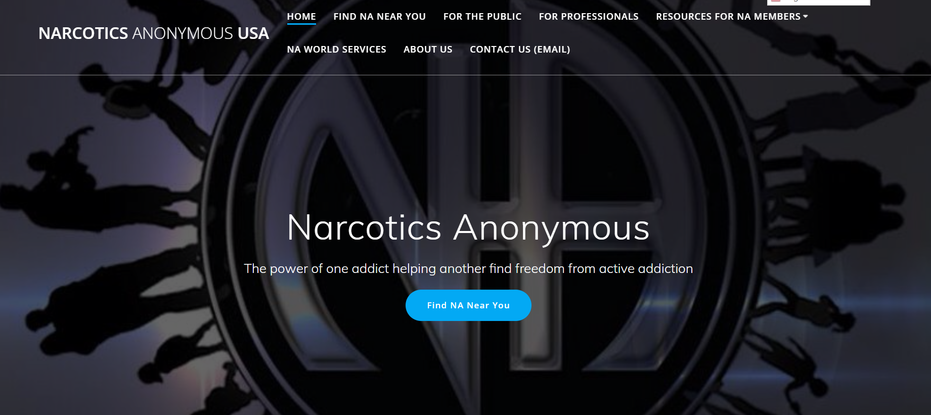
Information Technology
https://usa-na.org/

Slide 14
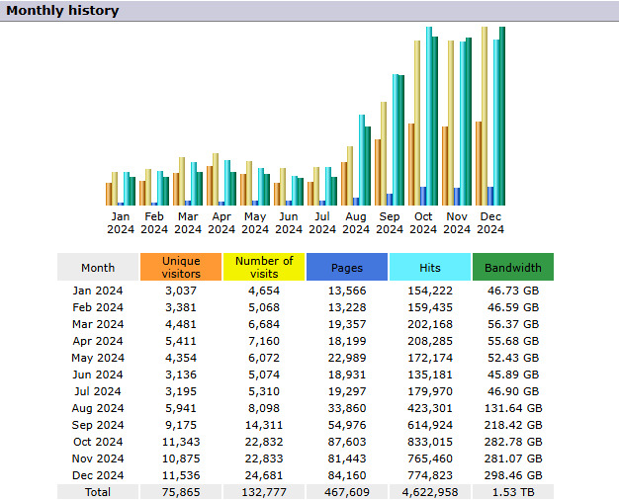
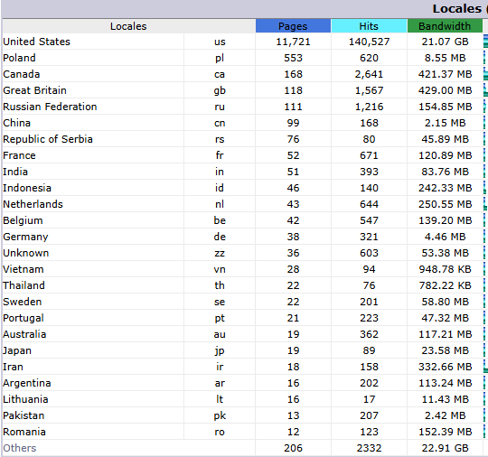
Information Technology
January 2024-December 2024
Monthly History
Locations

Slide 15

Public Relations
Oversees PR efforts for the US Collaboration of Zones, including:
🤝 Collaborating with Communications
  Responds to PR-related inquiries and requests
  Shares relevant information and resources
🎓 Providing PR Training
  Offers training upon request from the fellowship

Slide 16
Public Relations
Goal 2025-2026:
📣 Increase public awareness of NA through coordinated and proactive PR efforts across the US
Strategic Priorities
🔹 Priority #1: External Outreach
  Engage national organizations not currently connected with NA service bodies
  Use low- or no-cost methods (e.g., targeted emails, phone campaigns)
  Establish new relationships to strengthen NA’s national visibility
🔹 Priority #2: Internal Strengthening
  Connect experienced PR trusted servants from across the country
  Share "gold standard" PR resources for easy, consistent use by service bodies
  Build a strong foundation for a more unified collaboration of PR efforts
Notes:
We meet the first monday of each month!

Slide 17

Strategic Planning 2025
Priorities Identified & Two Projects Established
Public Relations
National Media / PSA’s
PR Collaboration
Attending national events
Fellowship Development
Marginalized Communities / Who’s missing / Rural support
Mentorship / Training / Consistency

Slide 18
Current Projects 2025
Mentorship / Training/ Consistency
Marginalized Communities / Rural Support

Slide 19

Mentorship / Training / Consistency
Goals:
🎓 Establish a training & mentorship mechanism to increase consistency in service delivery in the US
🌐 Heighten awareness of the US Collaboration as a trusted resource members can actively engage
Approaches:
🌍 Start local with focus first on zonal/regional mentorship projects
🗣️ Keep language simple; craft clear, accessible, inclusive messages regardless of experience
📄 Monthly “one-pagers”; create brief, focused resources on one topic per month
🤝 Identify mentorship needs; develop a process for recognizing members who need or want mentorship
📰 Newsletter: share updates and insights regularly
📌 Flyers & handouts: US Collaboration resource flyers
🔗 Website linking; request zones/regions to add the US Collab site to their websites

Slide 20
Mentorship / Training / Consistency
Phase 1 Approaches (July–October)
📝 Survey Development
  Collaborate with Rural Outreach Task Team
  Design and distribute the "Who's Missing?" survey
🎓 Basic Training Materials
  Develop short PDFs or videos on: RCM Basics, Facilitation Basics
🌐 Web Presence
  Add a new page on the US Collaboration website; training materials, videos, flyers
📣 Project Materials
  Create simple, clear flyers/one-pagers explaining the project
  Design a short video PSA
💬 Communication Tools
  Launch a Facebook group for information sharing
📢 Outreach to Zones & Regions
  Broadcast project to all Zones to share with regions

Slide 21

Marginalized Communities / Rural Support
Goals:
🌾 Heighten awareness & increase access to NA services in rural areas
🌍 Reach marginalized communities by identifying who may be missing from our fellowship
Approaches:
🧭 Define rural and marginalized communities
📊 Gather Info
  Create & distribute surveys
  Engage local service bodies
  Use SWOT(strengths, weakness, opportunity, threats)/SWAT (a=assumptions) analysis (Who’s Missing Surveys)
📣 Share Findings with the fellowship
🎓 Offer Training
  “Train the Trainer” sessions at zonal forums focused on rural support

Slide 22
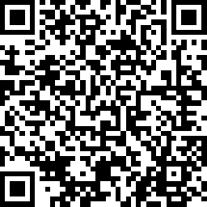
Marginalized Communities / Rural Support Survey; help us reach our goals

Slide 23

🗓️ US Collaboration of Zones Meeting Schedule
We would love your participation!
🌍 Quarterly Collaboration Meeting
  When: 2nd Sunday of January, April, July, October: 3 PM Pacific / 6 PM Eastern
  Zoom ID: 884 5012 6881/ Password: usa-na
🧩 Communications Workgroup
  When: 4th Tuesday monthly: 6 PM Pacific / 9 PM Eastern
  Zoom ID: 818 2584 3132/ Password : usa-na
💻 IT Workgroup
  When: 3rd Sunday monthly: 6 PM Pacific / 9 PM Eastern
  Zoom ID: 852 6997 3189/ Password : usa-na
📣 Public Relations Workgroup
  When: 1st Monday monthly: 6 PM Pacific / 9 PM Eastern
  Zoom ID: 864 4927 0474/ Password : usa-na

Slide 24
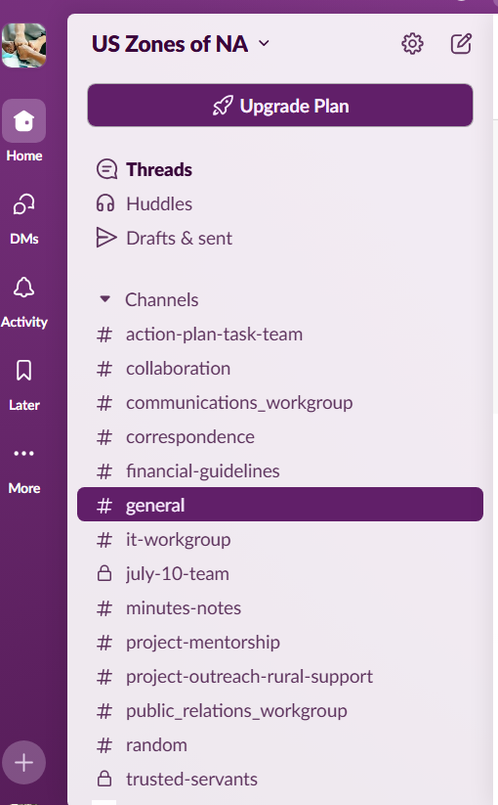
📬 Want to Stay Connected?
If you'd like to be added to our email list, join our Slack workspace, need more information:
📧 Contact us at: info@usa-na.org
🔗 Visit: https://usa-na.org/

Slide 25
On behalf of the US Collaboration of Zones We thank you for your support!

